Slide 1



UNIVERSITY OF BUEA
FACULTY OF ENGINERRING AND TECHNOLOGY
CEF440: INTERNET AND MOBILE PROGRAMMING TASK4
SYSTEM MODELING AND DESIGN
PRESENTED BY
TEMATEU ROXANNE
TIANI PEKINS
DERRICK FORCHA
BOUCHOUKE DANIEL
SAMUEL OSOH

Slide 2
Content
INTRODUCTION
CONTEXT DIAGRAM
USE CASE DIAGRAM
SEQUENCE DIAGRAM
CLASS DIAGRAM
DEPLOYMENT DIAGRAM
CONCLUSION

Slide 3




INTRODUCTION
The design process follows a structured approach, including various diagrams to model the system comprehensively:
A. Context Diagram
B. Use Case Diagram
C. Sequence Diagram
D. Class Diagram
E. Deployment Diagram

Slide 4


A. CONTEXT DIAGRAM
Context Diagrams are high-level visual representations that show the interactions between a system being developed and its external entities, such as users, other systems, or processes.

Slide 5
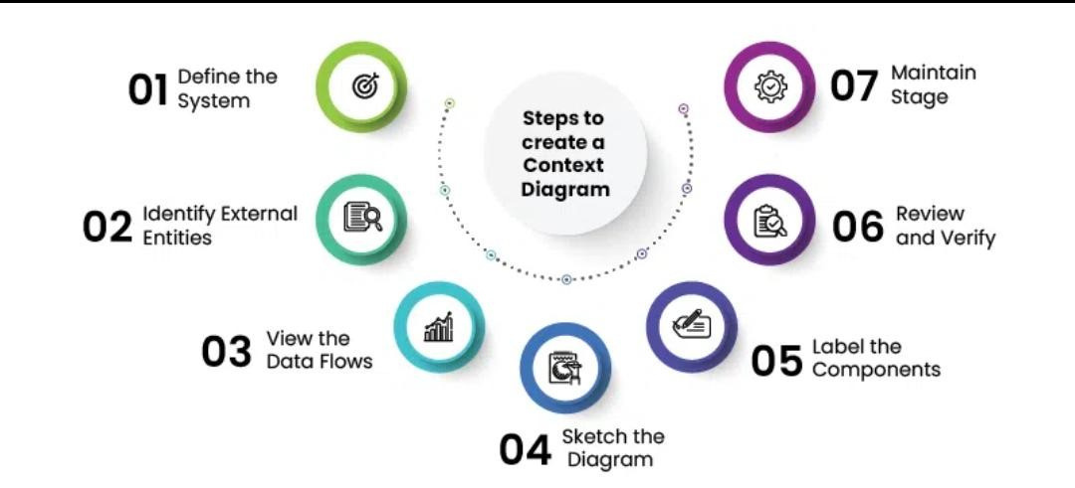
figure depicting how Steps to create a Context Diagram

Slide 6
PROJECT
Let’s understand Context Diagram for the archival and retrieval of missing object using an image matching algorithm
⦁ ADMINISTRATORS
⦁ DATABASE
⦁ User names, ID and contact,
⦁ Objects id and location etc.
⦁ USER’S INFO
⦁ SYSTEM

Slide 7
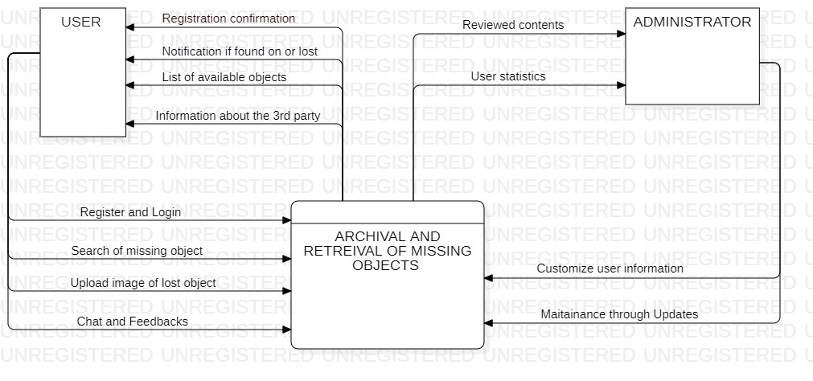
Figure representing the Context Diagram of our system

Slide 8
Advantages
⦁ CLARITY
⦁ COMMUNICATION
Below are the benefits of using Context Diagram:
⦁ RISK IDENTIFICATION
⦁ SCOPE DEFINITION
⦁ DEPENDENCY MANAGEMENT

Slide 9


B. USE CASE DIAGRAMS
DETAILS FUNCTIONALITIES BASED ON THE CONTEXT. FOCUSES ON USER ACTIONS (NAVIGATION, REPORT HAZARDS, ETC.). SHOWS INTERACTIONS BETWEEN USERS AND THE APP FUNCTIONALITIES..

Slide 10
ACTORS AND USECASES
⦁ PRIMARY ACTORS, USERS
⦁ SECONDARY ACTORS, USERS
⦁ Login
⦁ Upload Profile
⦁ Report Lost Object
⦁ Report Found Object
⦁ View Achieved Object list
⦁ Send Feedback
⦁ Maintenance
⦁ Update
⦁ TERTIARY ACTORS
⦁ API
⦁ Phone Features

Slide 11
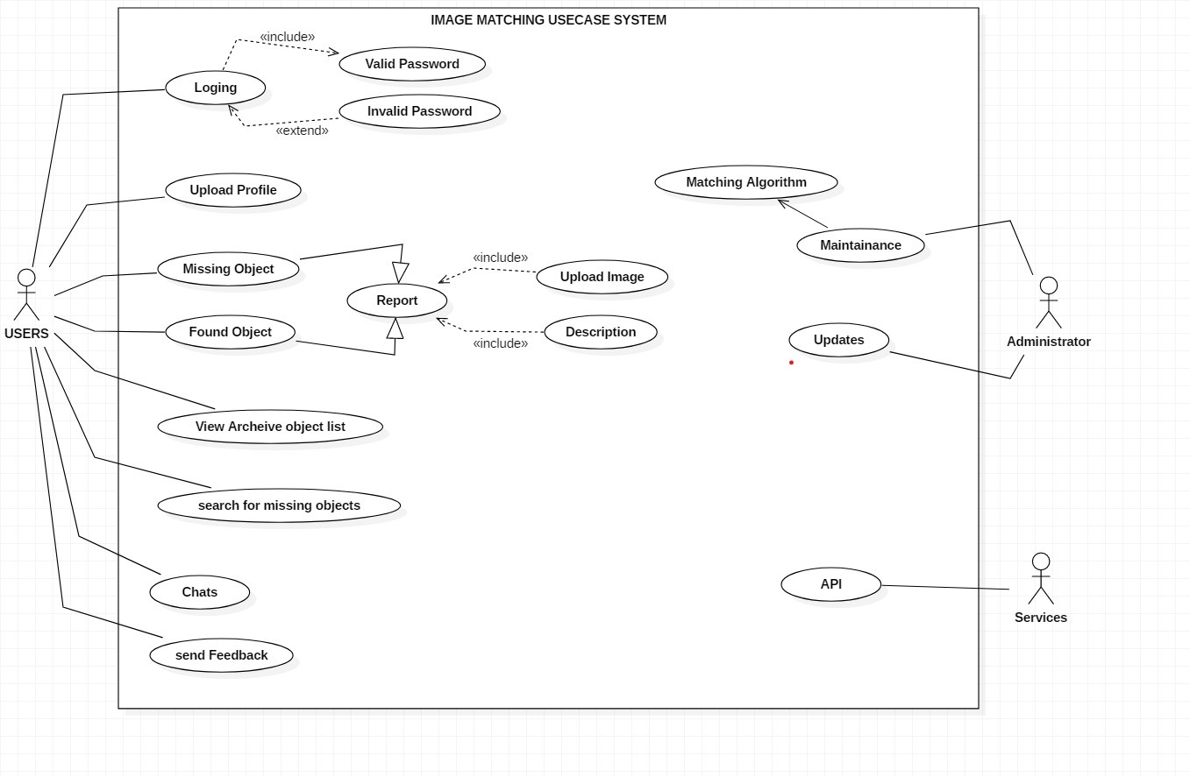
Figure depicting the use case Diagram for our system

Slide 12

C. SEQUENCE DIAGRAMS
DIVES INTO SPECIFIC ACTIONS WITHIN USE CASES. ZOOMS IN ON A SPECIFIC USE CASE (E.G., NAVIGATION). LLUSTRATES THE SEQUENCE OF MESSAGES EXCHANGED BETWEEN APP COMPONENTS TO COMPLETE A USECASE. .

Slide 13
ACTORS AND USECASES
PARTICIPANTS
MESSAGE FLOW
⦁ Users
⦁ System
⦁ Server
⦁ Matching algorithm service
⦁ Email
⦁ Camera

Slide 14
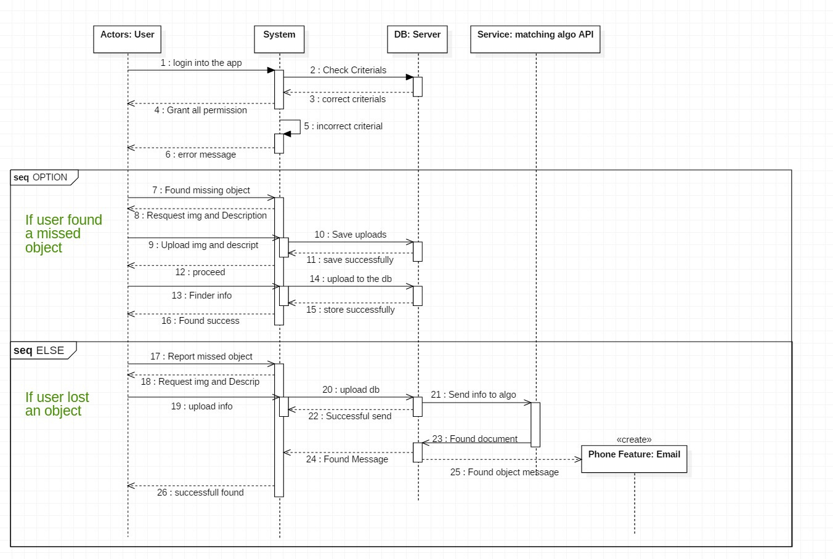
Figure depicting the sequence Diagram for our system

Slide 15

D. CLASS DIAGRAMS
A CLASS DIAGRAM IS A TYPE OF STATIC STRUCTURE DIAGRAM IN THE UNIFIED MODELING LANGUAGE (UML) THAT REPRESENTS THE STRUCTURE AND RELATIONSHIPS OF CLASSES IN A SYSTEM OR SOFTWARE APPLICATION.

Slide 16
CLASSES
CHARACTERISTICS
ATTRIBUTES
METHODS
RELATIONSHIPS

Slide 17
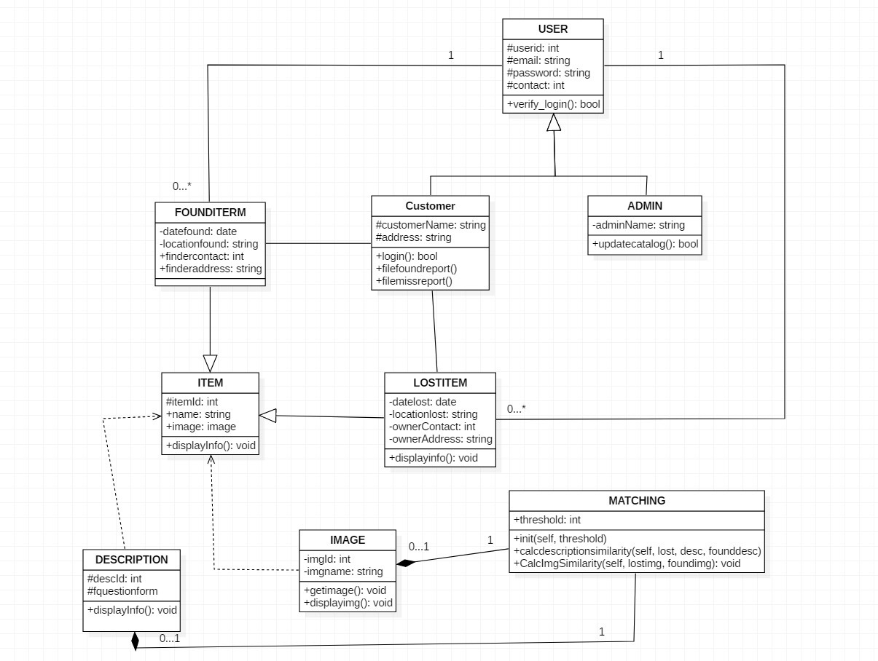
Figure depicting the class Diagram for our system

Slide 18
Advantages of a class diagram
⦁ VISUALIZATION OF STRUCTURE
⦁ REUSABILITY
beside are the various advantages of using a class Diagram for our archival and retrieval of missing object using an image matching algorithm
⦁ MODULARITY
⦁ ABSTRACTION

Slide 19
E. DEPLOYMENT DIAGRAM
THE DEPLOYMENT DIAGRAM DESCRIBES THE PHYSICAL DEPLOYMENT OF INFORMATION GENERATED BY THE SOFTWARE PROGRAM ON HARDWARE COMPONENTS.

Slide 20
USER DEVICE (CLIENT)
CHARACTERISTICS
INTERNET
INTERNAL SERVER
IMAGE MATCHING SERVER
PHONE CAMERA SERVICES

Slide 21
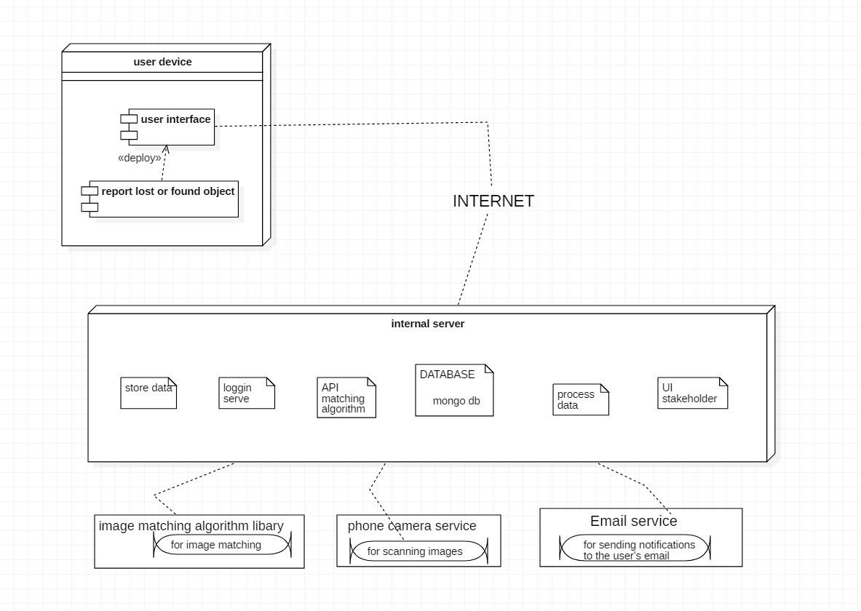
Figure depicting the deployment Diagram for our system

Slide 22
CONCLUSION
In conclusion, the modeling and design phase of building a mobile app lays the foundation for its functionality and user experience. Through careful consideration of user flows, database interactions, and system architecture, the app's structure is defined. Clear modeling helps ensure that the app meets user needs efficiently and effectively. Additionally, robust design choices contribute to a seamless and intuitive user interface, enhancing overall usability.

Slide 23




THANK YOU
For watching this presentation

